Slide 1
CSS Grid Layout
Notes:
What is CSS Grid?
Well, it is an answer to a problem.

Slide 2
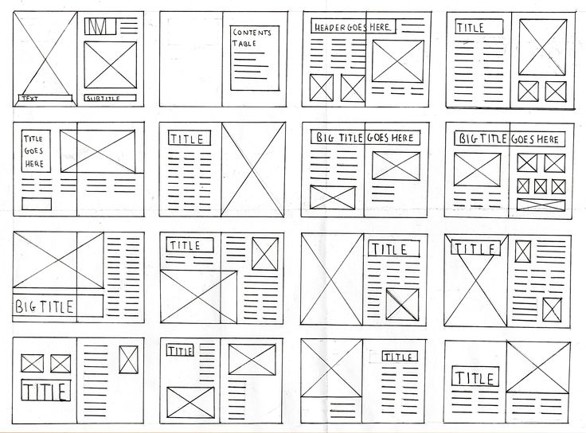
Notes:
Traditionally in print media, images, text, sections of content are arranged on a series of intersecting lines. This grid system structures elements out in a rational easy to absorb way. It is pleasing to the eye and provides a map for the reader.

Slide 3
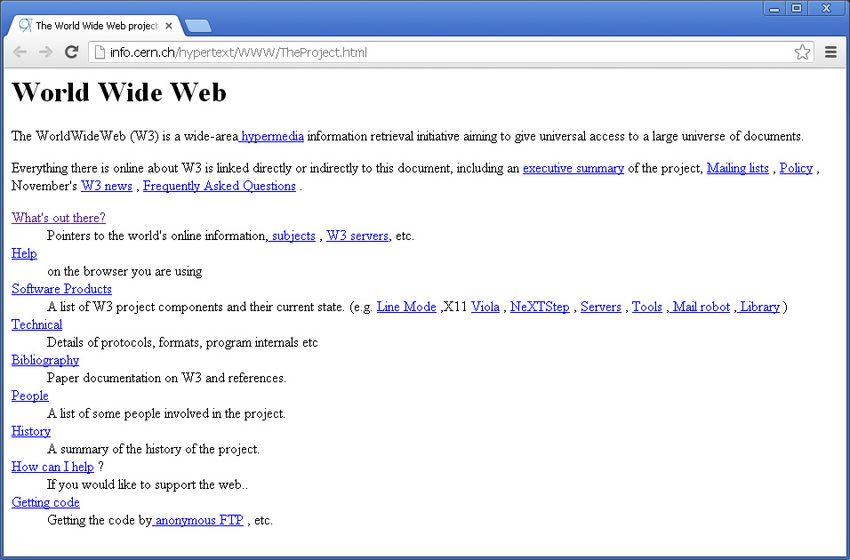
<h1>World Wide Web</h1>
<H1>World Wide Web</H1>
The WorldWideWeb (W3) is a wide-area
<A NAME=0 HREF="WhatIs.html">
hypermedia</A> information retrieval
initiative aiming to give universal
access to a large universe of documents.
Notes:
Unfortunately, the web has not always been so grid friendly. Webpages began as just markup, so while it was informative and did have the tools to say, “This is the title!” “This is the content!”, it was visually unappealing.

Slide 4
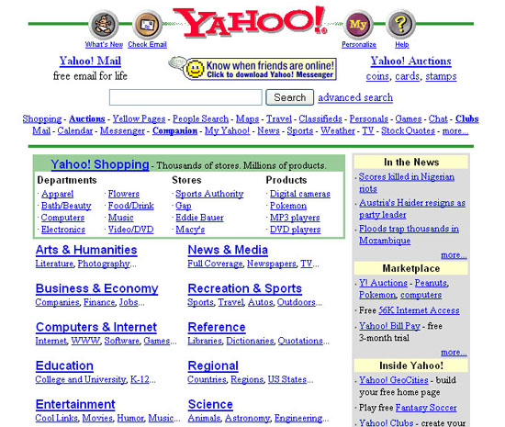
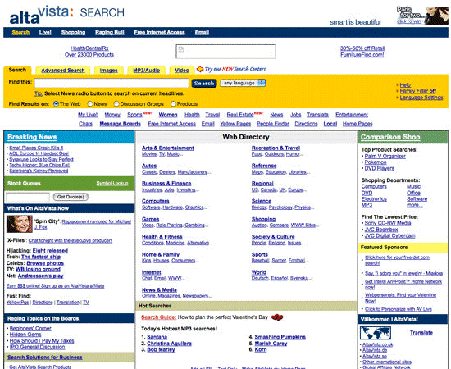
Notes:
Eventually, design started to play a roll in web page design. Images came in to play and we got cool little navigation panes called frames. Frames could be set as a column or a row. They provided a way to provide a dynamic web page experience with static controls.
Tables brought structure to web design. Content was now able to be placed into tables rows. Some designers were even able to get crafty with photoshop to slice elaborate designs into cells.
This, however, require extensive markup and could be load heavy depending on the content.

Slide 5
CSS Grid Layout
Notes:
This is great for a while, until phones, tablets and different display ratios became available.
With the increase of mobile devices came an increase for a responsive approach to design.

Slide 6
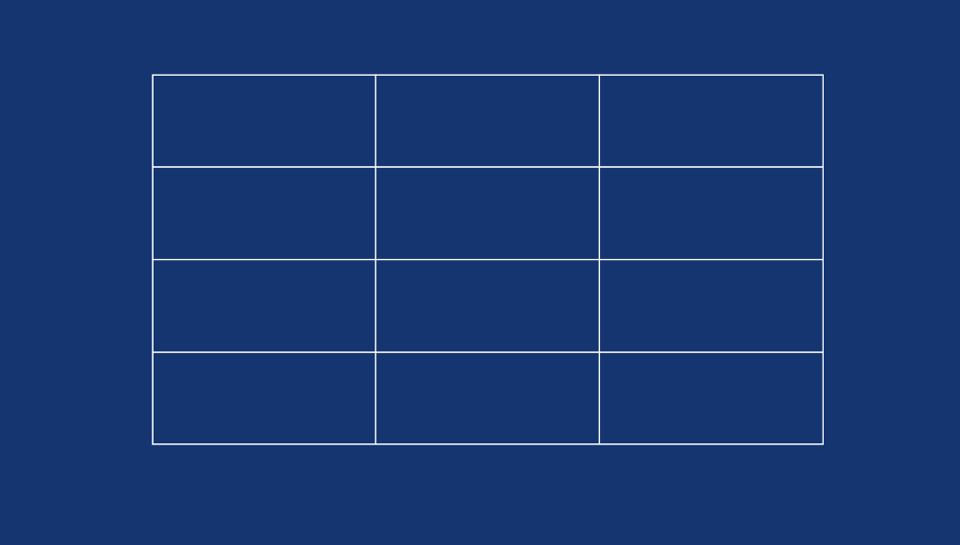
The Grid

Slide 7
Grid Cell

Slide 8
Grid Area

Slide 9
Grid Tracks

Slide 10
Grid Lines

Slide 11
Grid Lines
1
2
3
4

